Slide 1

UL Accreditations
January 2011

Slide 2



Accreditations
Started with a CAR?
What is above and beyond?
What accreditations does UL have?

Slide 3

Accreditations
A2LA
CAR
10398300

Slide 4
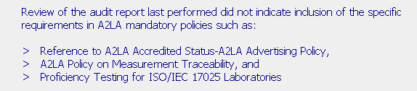
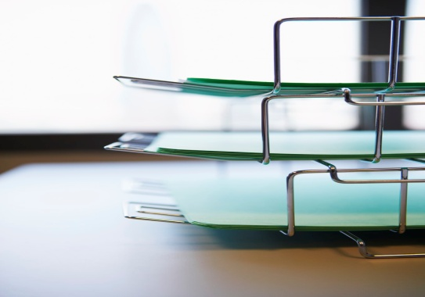

A2LA Finding

Slide 5


Accreditations
Regulatory Services
How to capture the accreditations
IQA – UL Accreditations

Slide 6
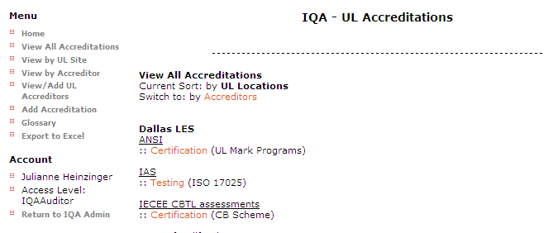

Accreditations

Slide 7

Accreditations

Slide 8

A2LA & IAMPO Requirements
January 2011

Slide 9

American Association for Laboratory Accreditation
A2LA offers programs for the accreditation of testing laboratories, calibration laboratories, inspection bodies, proficiency testing providers, medical testing laboratories, reference material producers and product certification bodies.

Slide 10
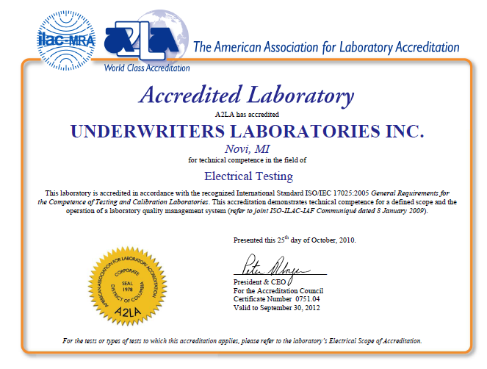

Slide 11

American Association for Laboratory Accreditation
A2LA Explanations for the ISO/IEC 17025 Requirements
Accessible through a2la.org
  Explanations
  Specific Requirements

Slide 12
Requirements from R101 – General Requirements . . .
The general requirements (general criteria) for A2LA accreditation are the international standard, ISO/IEC 17025:2005, General Requirements for the Competence of Testing and Calibration Laboratories. A2LA’s official applications of the ISO/IEC 17025 requirements are contained on the A2LA website (www.A2LA.org) under the section titled, “A2LA Additional ISO/IEC 17025 Requirements”, and are updated frequently. It is expected that laboratories will implement the requirements of the standard in accordance with the applications listed there. Otherwise, areas of non-conformance will be identified by the assessor during the on-site assessment.

Slide 13

What is meant by the term “legally responsible?”
04/30/2005
4.1.1
2005
The laboratory may be a public or private entity, an established business or corporation, or an identifiable division or in-house activity of a business or corporation, which meets the applicable legal requirements of the governmental jurisdiction in which it conducts business. Legal responsibility aids in addressing issues of liability/accountability, uniqueness, and independence of operation.

Slide 14

A2LA - Requirements
Advertising Policy

Slide 15
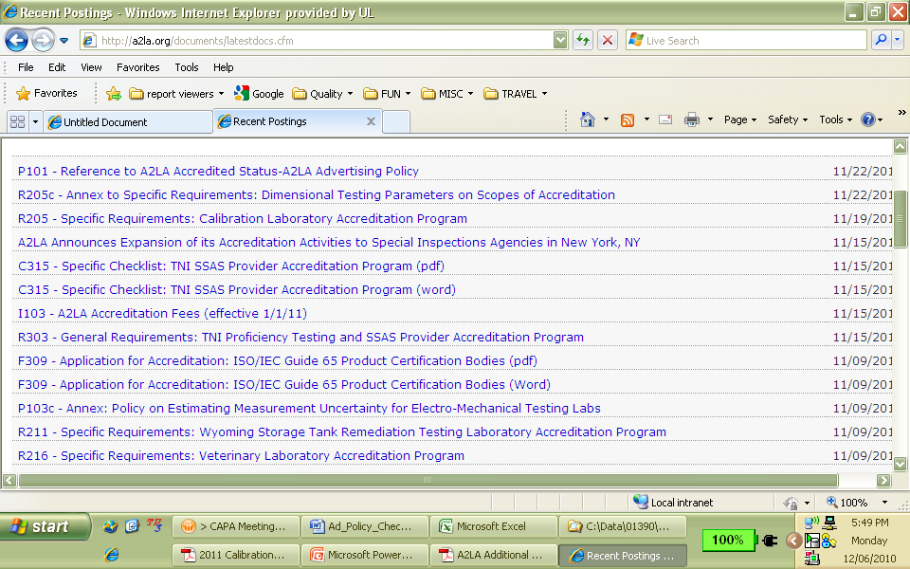

Slide 16

A2LA Checklists
Checklists
  Advertising Policy
  Proficiency Testing
  Measurement Traceability

Slide 17
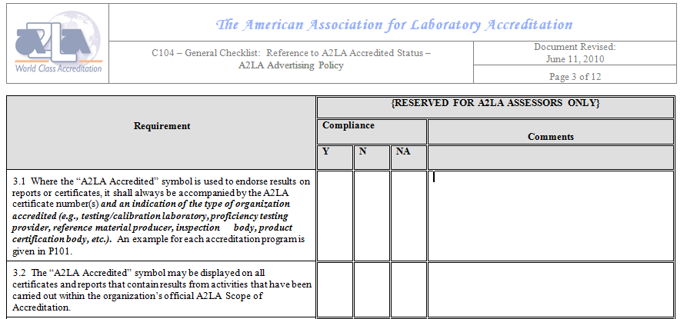

Slide 18

A2LA Accreditation
Applies to sites accredited by A2LA.

Slide 19
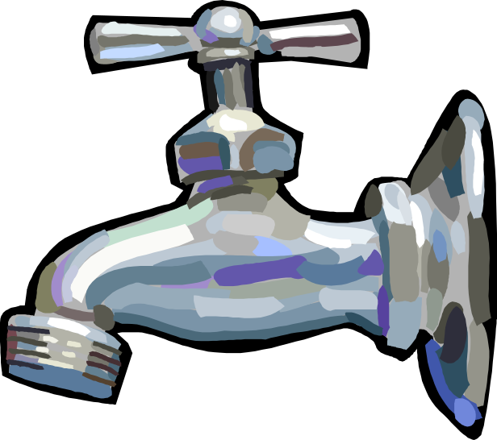
IAMPO
International Association of Plumbing and Mechanical Officials

Slide 20


Additional IAMPO requirment
Required to provide IAPMO test results using an IAPMO formatted Test Report

Slide 21
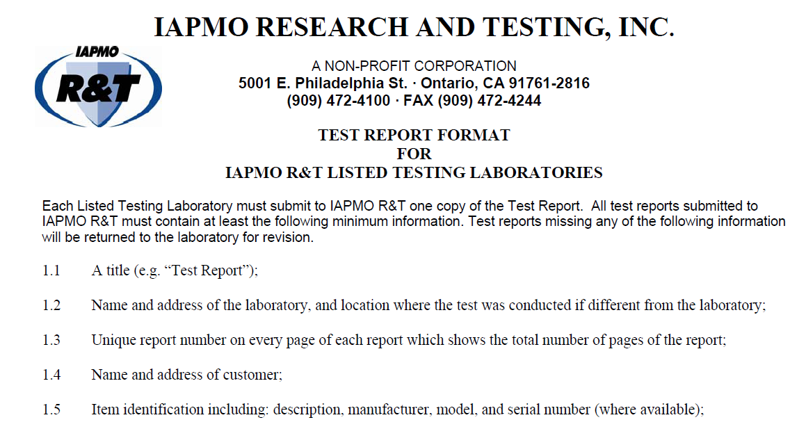

Additional IAMPO requirments

Slide 22

IAMPO scope at NBK
APPLIANCES:
AHAM DW-2PR, AHAM HLW-2PR, ANSI Z21.13(Witness Test), ASSE 1006, 1007, 1008, 1023, MIL-P-21214B, MIL-P-52407(A), NSF 3(Witness Test), UL 80(Witness Test), 103, 352, 430, 441, 499, 563, 726, 749, 778(Witness Test), 834, 921, 1453,
BACKFLOW PREVENTERS:
ASME A112.14.1(Witness Test), ASSE 1021(Witness Test), ASSE 1037(Witness Test)
BALLCOCK/FLUSHOMETERS:
ASSE 1002(Witness Test), ASSE 1037(Witness Test)
CEMENT/ SOLDER /JOINT COMPOUND:
ASTM D2672(Witness Test), F402(Witness Test)

Slide 23
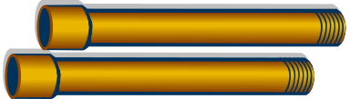
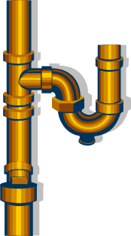
IAMPO scope at NBK
FUEL GAS ITEMS:
ANSI Z21.41(Witness Test), UL 144, UL 569, NFPA 99(Witness Test), 99C(Witness Test)(Witness Test)
METAL FIXTURES:
ASME A112.19.9M (CSA, B45.1-94)(Witness Test), A112.19.3M (CSA, B45.4-94)(Witness Test), A112.19.4M (Witness Test), PS 117(Witness Test)
METAL PIPE/FITTINGS:
ASME B16.1(Witness Test), ASME B16.3(Witness Test), ASME B16.4(Witness Test), AWWA C151/A21.51(Witness Test), AWWA C153/A21.53(Witness Test), IAPMO PS 53(Witness Test), UL 213
PLASTIC FIXTURES:
ASME A112.19.1M (CSA, B45.1-94)(Witness Test), ANSI Z124.9,
(ANZI Standards as listed below except Flammability):
ANSI Z124.1.2(Witness Test), Z124.3(Witness Test), Z124.4(Witness Test), Z124.5(Witness Test), Z124.6(Witness Test), Z124.7(Witness Test)

Slide 24

IAMPO scope at NBK
PLASTIC PIPE/FITTINGS (Standards as listed below except Impact Testing):
ASTM D1785, 2464, 2466, 2467, 2665(CSA, CAN/CSA-B181.2-M90) (Witness Test), 2729(Witness Test), 3034(CSA, CAN/CSA-B182.2-M90) (Witness Test), 3212(Witness Test), ASTM F794, F877(except section 7.5 thermocycling)(Witness Test), F891(Witness Test), AWWA C900(Witness Test), NSF 14(Except Impact Testing)
POOL/SPA COMPONENTS\FITTINGS:
ASME A112.19.7M (CSA, CAN/CSA-B45S1-88)(Except Sections 3.2 and 3.3.1), A112.19.8A(Witness Test)
SEPTIC SYSTEMS:
ASTM C478
TOXICITY:
NSF 60, 61

Slide 25

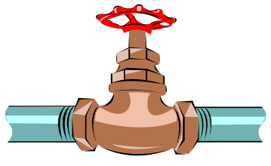
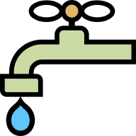
IAMPO scope at NBK
VALVES/FAUCETS:
ASME A112.18.1/CSA B125.1(except 5.10.6), CSA B70-CAN/CSA UPD3(Witness Test), ASME B1.20.1, ASSE 1014(Witness Test), ASSE 1016 (Witness Test), ASSE 1062(Witness Test), UL 399
VITREOUS CHINA FIXTURES:
ASME A112.19.2M(Witness Test)
WATER CLOSETS:
ASME A112.19.5(Witness Test)
WATER HEATERS:
ANSI Z21.10.3(Witness Test), Z21.10.3a(Witness Test), Z21.10.3b(Witness Test), Z21.10.1a(Witness Test), Z21.10.1b(Witness Test), UL 174, UL 732, AWWA C/110A21.10(Witness Test)

Slide 26

Notes:
CPC Annual Management Review
2007-03-28
Underwriters Laboratories Inc.
Page <number>

